Slide 1


Earliest deadline late server
Masrur jamil Prochchhod

Slide 2
Motivation

Slide 3
Earliest deadline late server
Prioritization
Preemptive Scheduling
Uses EDS and EDL

Slide 4
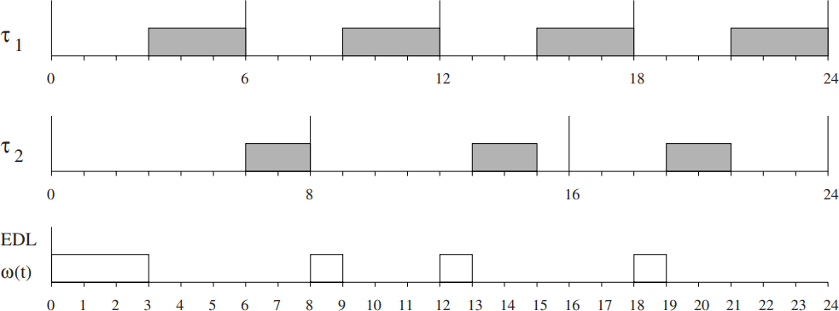
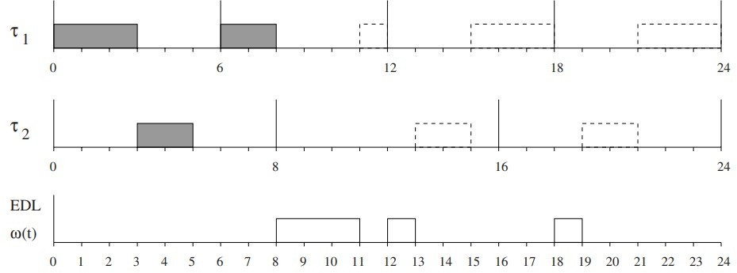
Edls algorithm
Fig 01 EDLS Algorithm
Fig 02 Availability of Idle Time
Fig 03 Scheduling of Aperiodic task

Slide 5
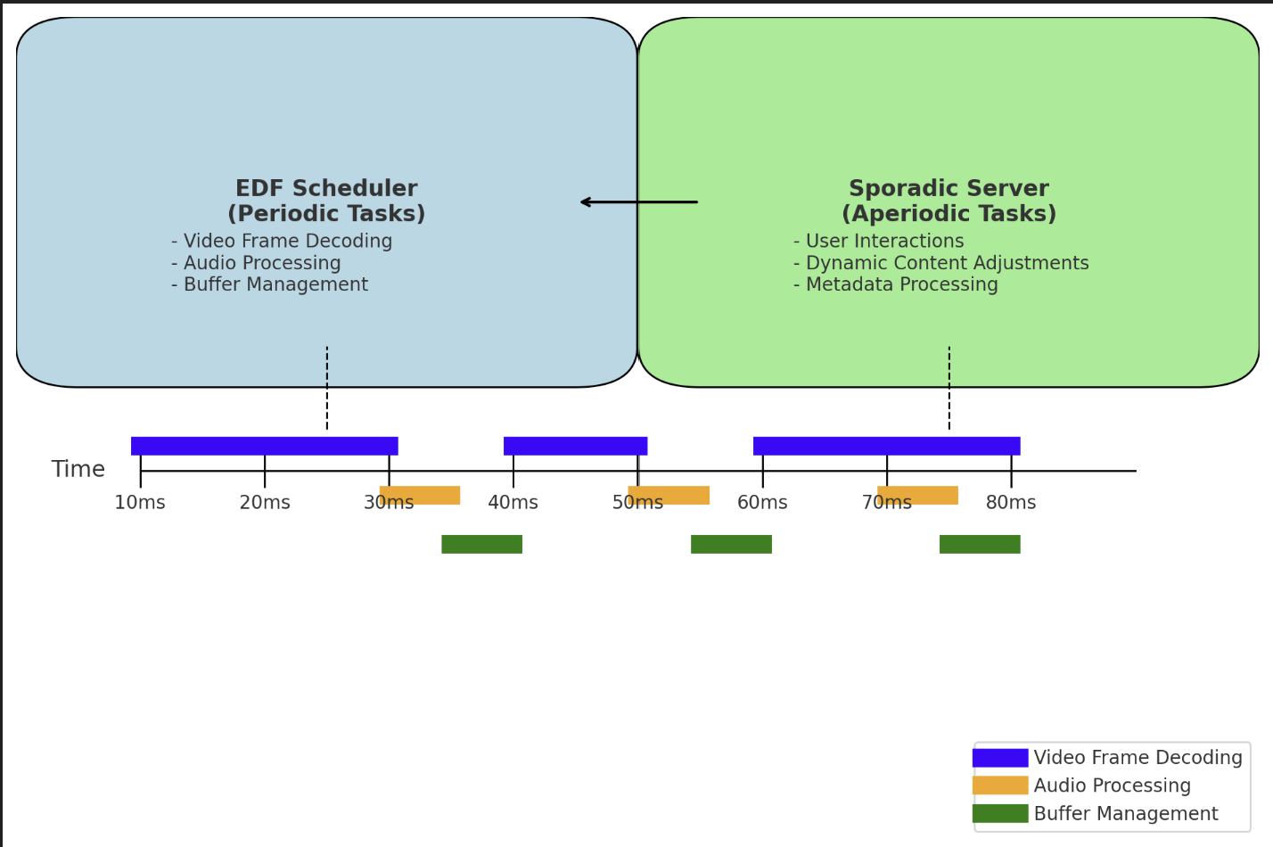
application
Multimedia Streaming System
Fig 04 EDLS in Multimedia Streaming Device

Slide 6
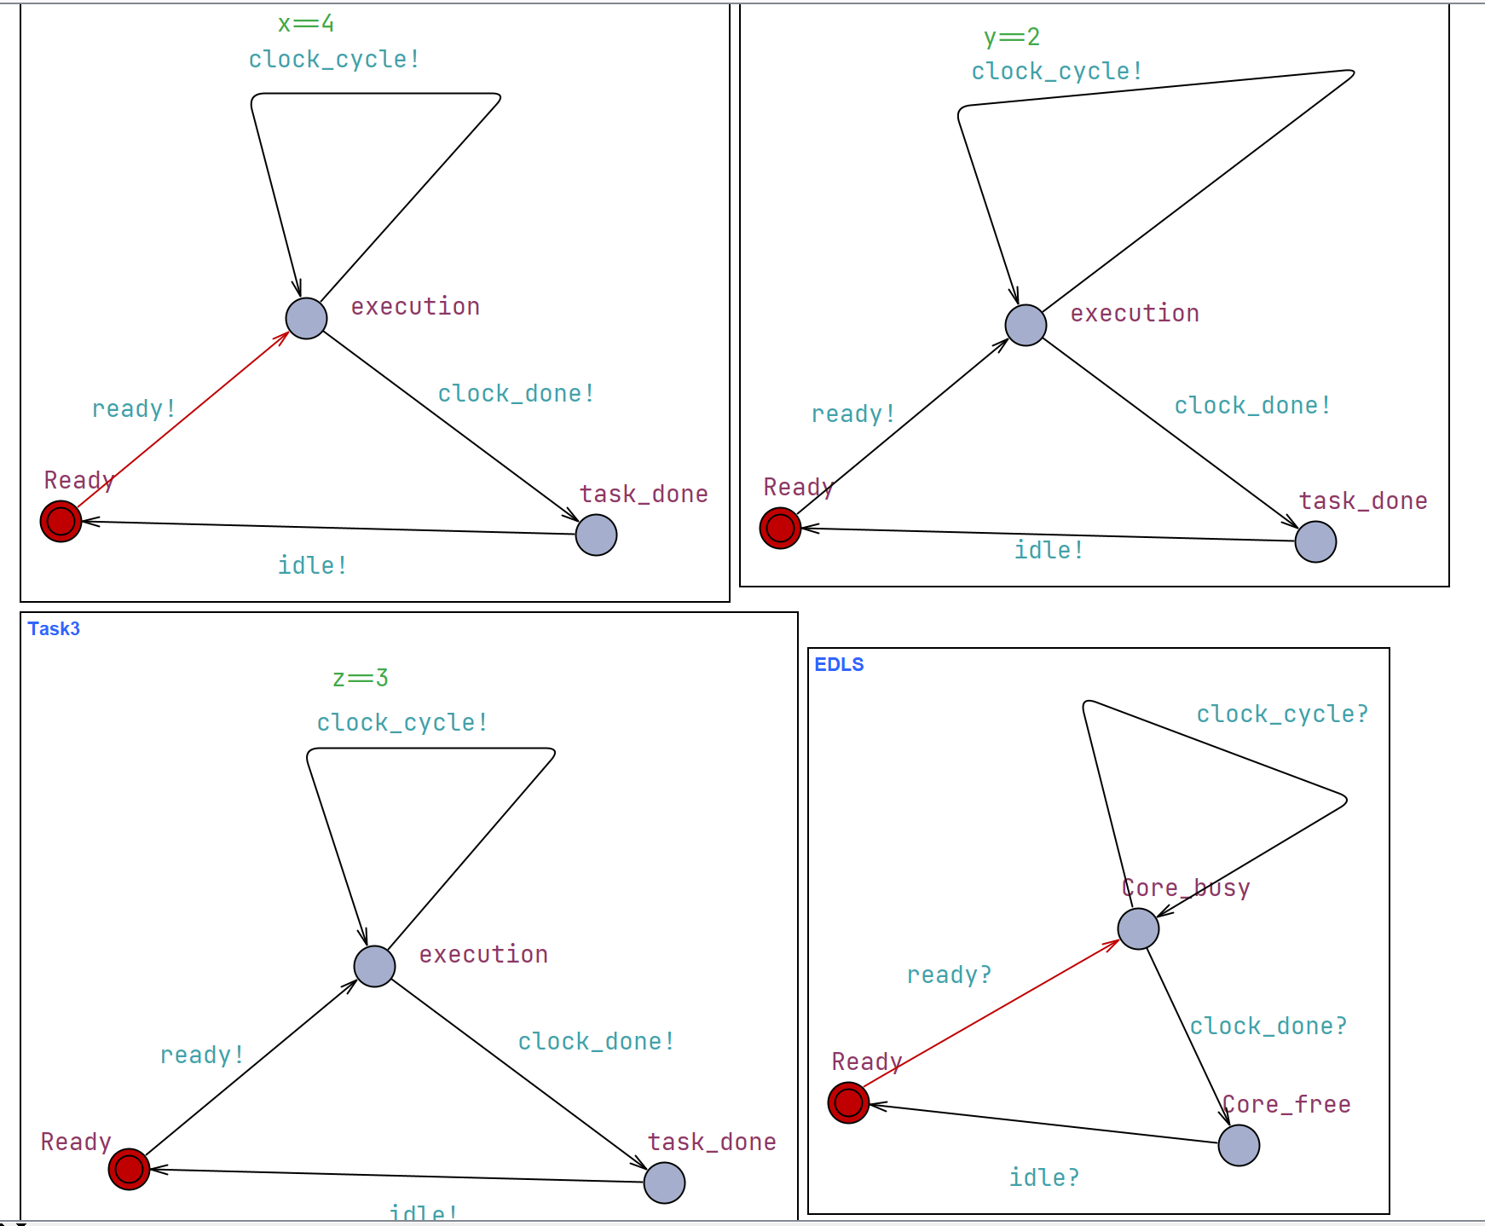
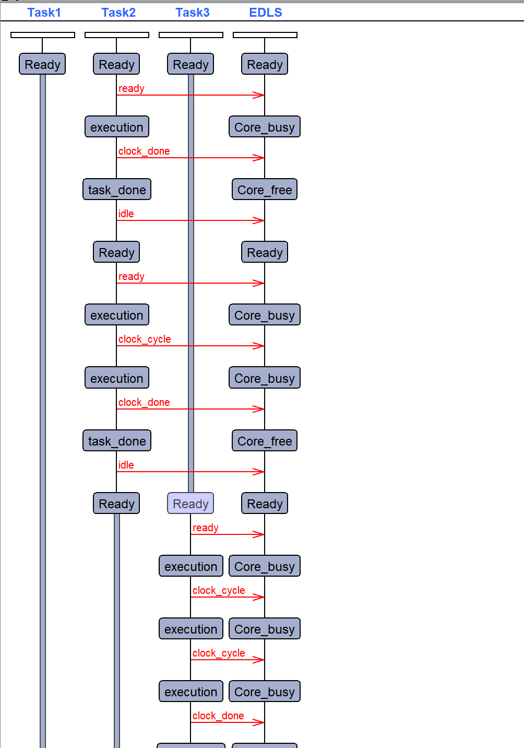
Uppaal model and sequence diagram
Fig 05 Uppaal Model
Fig 06 Sequence Diagram

Slide 7
Pro and cons of earliest deadline late server
Advantages
Efficient Deadline Management
Balance Task Scheduling
Improved System Utilization
Quality of Service
Flexibility
Disadvantages
Complex Implementation
Overhead
Scalibility Issues

Slide 8
summary
Effective management of both periodic and aperiodic tasks in real time system.
Optimize idle time and dynamically adapt the scheduling strategy in response to aperiodic task arrivals
Ensures that tasks with imminent deadlines are processed first, reducing the risk of missing deadlines.
Helps in maintaining system responsiveness and meeting timing requirements efficiently.
It faces some challenges in overhead, scalability issues and complex implementation.
Applicable in embedded system, multimedia and streaming devices and telecommunication networks.

Slide 9
References
Silly, M. The EDL server for scheduling periodic and soft aperiodic tasks with resource constraints. Real-time systems 17, 87–111 (1999). Https://doi.Org/10.1023/a:1008093629946
H. Chetto and M. Chetto, “some results of the earliest deadline scheduling algorithm,” IEEE trans. On software engineering, 15(10), 1261- 1269, 1989.
A. Marchand and M. Chetto, ”dynamic scheduling of periodic skippable tasks in an overloaded real-time system,” 2008 IEEE/ACS international conference on computer systems and applications, doha, qatar, 2008, pp. 456-464, doi: 10.1109/aiccsa.2008.4493573.
Hard real-time computing systems: predictable scheduling algorithms and applications - second edition, springer 2005 january 2011 doi: 10.1007/978-1-4614-0676-1 ISBN: 978-1-4614- 0675-4 giorgio C. Buttazzo

